Slide 1
20190311
Machine Learning를 이용한 1D DBR 설계
ARLA algorithm
Q Learning algorithm
Deep Q Learning algorithm
Lee Jong Geon

Slide 2
Artificial Intelligence
Machine Learning
Supervised
Learning
Unsupervised Learning
Reinforcement
Learning
Classification
Clustering, recommendation
Reward maximization

Slide 3



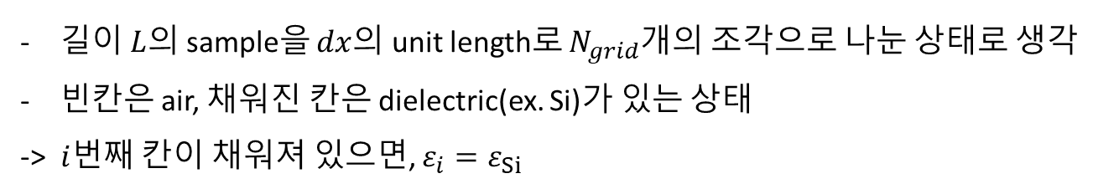
1D DBR model
$$L=N_{grid}∗dx$$
$$dx$$
$$i$$
…
길이 $L$의 sample을 $dx$의 unit length로 $N_{grid}$개의 조각으로 나눈 상태로 생각
빈칸은 air, 채워진 칸은 dielectric(ex. Si)가 있는 상태
-> $i$번째 칸이 채워져 있으면, $ε_{i}=ε_{Si}$

Slide 4
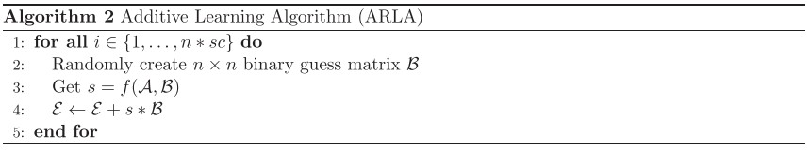
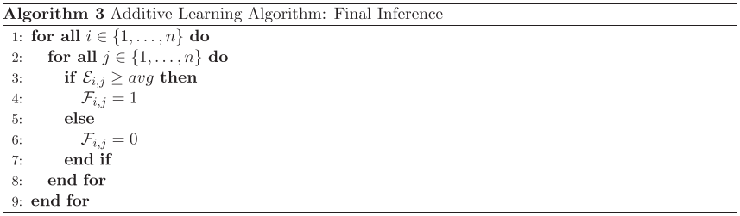
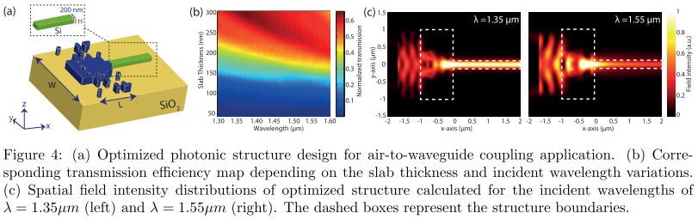
ARLA (Additive Reinforcement Learning Algorithm)
2017-arXiv-Binary Matrix Guessing Problem (Cagri Latifoglu)
2017-arXiv-Machine learning based compact photonic structure design for strong light confinement (Mirbek Turduev, Cagri Latifoglu, Ibrahim Halil Giden, Y. Sinan Hanay)
Reward 함수 f의 값을 $ℰ$에 acculmulate한다.
$ℰ_{i,j}$에 저장된 값이 $ℰ_{avg}$보다 크면 1, 작으면 0이 $\left(i,j\right)$의 값이 된다.

Slide 5
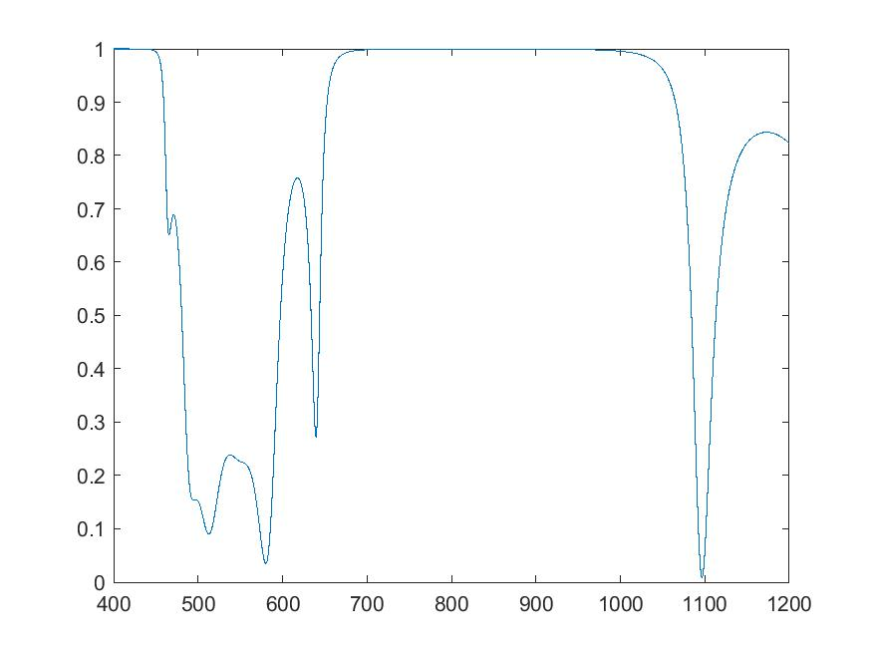
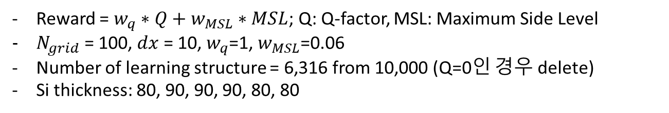
ARLA (Additive Reinforcement Learning Algorithm)
Air
Si
Reward = $w_{q}∗Q+w_{MSL}∗MSL$; Q: Q-factor, MSL: Maximum Side Level
$N_{grid}$ = 100, $dx$ = 10, $w_{q}$=1, $w_{MSL}$=0.06
Number of learning structure = 6,316 from 10,000 (Q=0인 경우 delete)
Si thickness: 80, 90, 90, 90, 80, 80

Slide 6
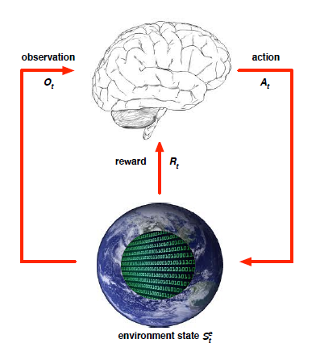
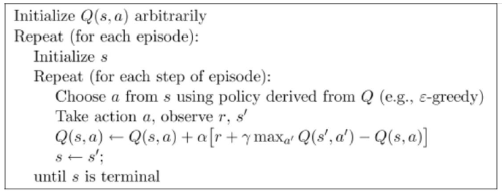
Q Learning
State(s), action(a), reward, state transition probability
Q: action-value function which let us know the expected sum of future rewards at given state
$$Q\left(s_{t},a_{t}\right) ←Q\left(s_{t},a_{t}\right)+α\left[r_{t+1 }+γ\max_{a}{Q\left(s_{t+1},a\right)}−Q\left(s_{t},a_{t}\right)\right]$$
The New Action Value = The Old Value + The Learning Rate*(The New Information – The Old Information)

Slide 7
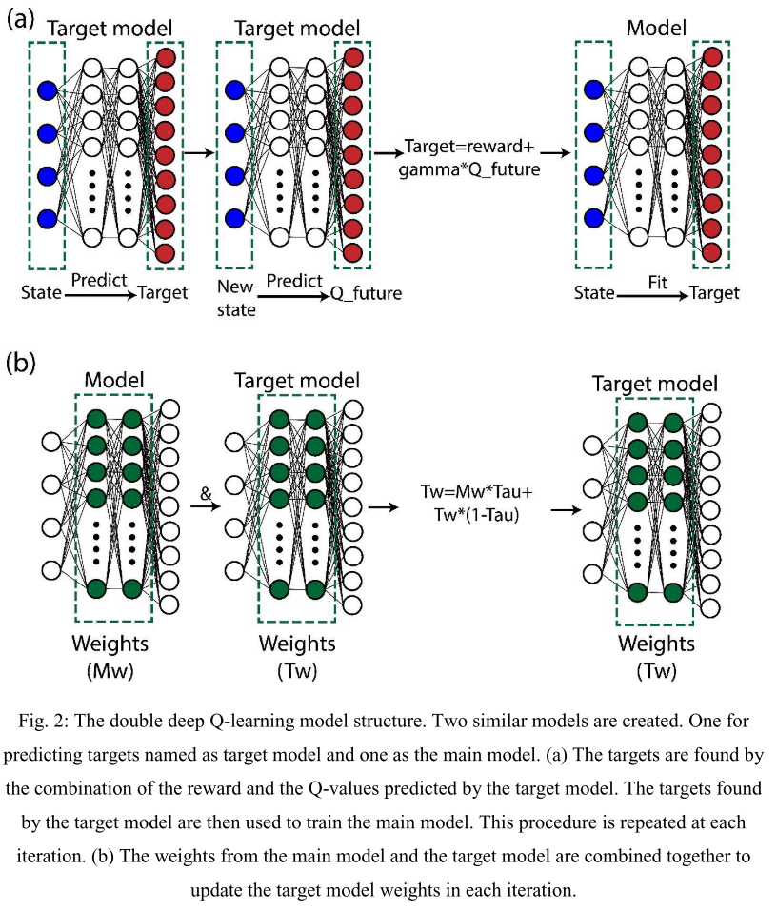
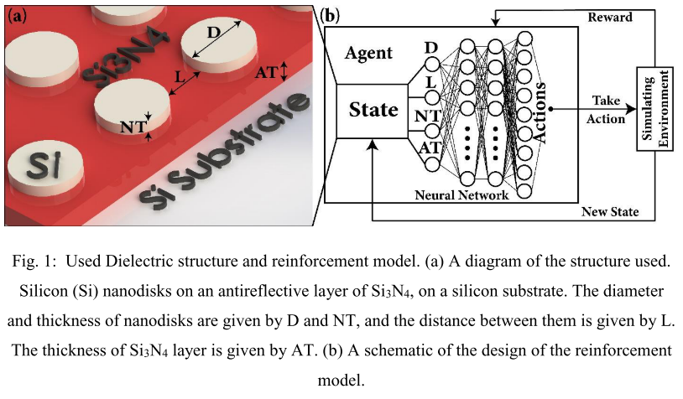
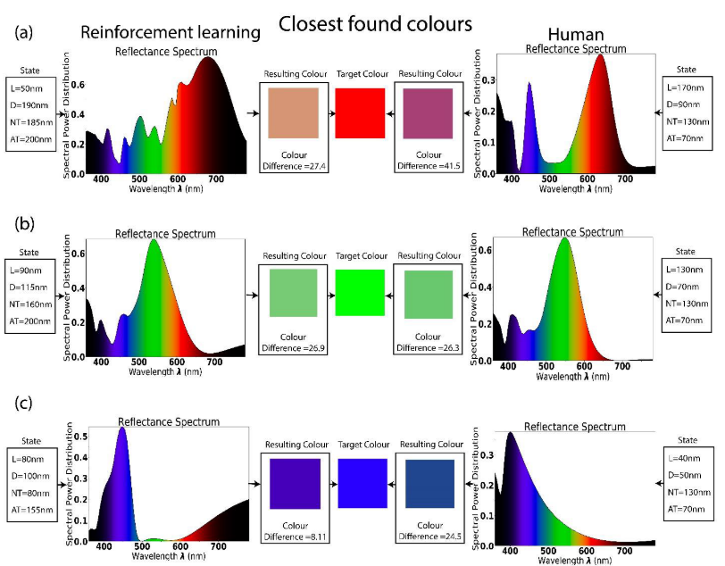
Deep Q Learning
2018-arXiv-Finding the best design parameters for optical nanostructures using reinforcement learning (Iman Sajedian, Trevon Badloe, Junsuk Rho)

